Slide 1
Traffic Crashes in the city of Chicago
GROUP:3
Abhigna Balusani & Supriya kumari Kushwaha
IE6600: COMPUTATION & VISUALIZATION FOR ANALYTICS

Slide 2
Why this dataset?
The World Health Organization (WHO) estimated that around 1.19 million people die each year as a result of road traffic crashes, with an additional 20-50 million sustaining non-fatal injuries. (Ref: https://www.who.int/health-topics/road-safety#tab=tab_1)
Low- and middle-income countries account for a disproportionate share of road traffic fatalities, despite having a lower number of vehicles compared to high-income countries.
These crashes incur a heavy economic burden on victims and their families, both through treatment costs for the injured and through loss of productivity of those killed or disabled. Moreover, they create a serious impact on national economies, costing countries 3% of their annual GDP.
Due to the thousands of avoidable deaths and injuries that occur every day worldwide, road safety is a vital issue that directly affects people's everyday lives. To help address these urgent road safety issues, an analysis of these statistics can yield insightful information.

Slide 3
More about this dataset…
FEATURES
FOCUSSED ATTRIBUTES
ROWS: 824K
COLUMNS: 48
FILE SIZE: 422.246 MB
DATA PROVIDED BY: CHICAGO DATA PORTAL
POSTED SPEED LIMIT
TRAFFIC CONTROL DEVICE
DEVICE CONDITION
WEATHER CONDITION
LIGHTING CONDITION
CRASH TYPE
CRASH MONTH
STREET NAME
DAMAGE
INJURIES TOTAL

Slide 4
Aims
Analyse the crash dataset for nine years to see whether accident trends have changed and to pinpoint the underlying causes of these changes.
To determine the total impact of these incidents, assess the monetary and human losses that arise from the crashes.
Use this dataset’s insights to improve the optimization of traffic management tactics.
To increase efficiency and effectiveness in handling disasters, strengthen emergency response procedures based on a complete examination of the crash dataset

Slide 5
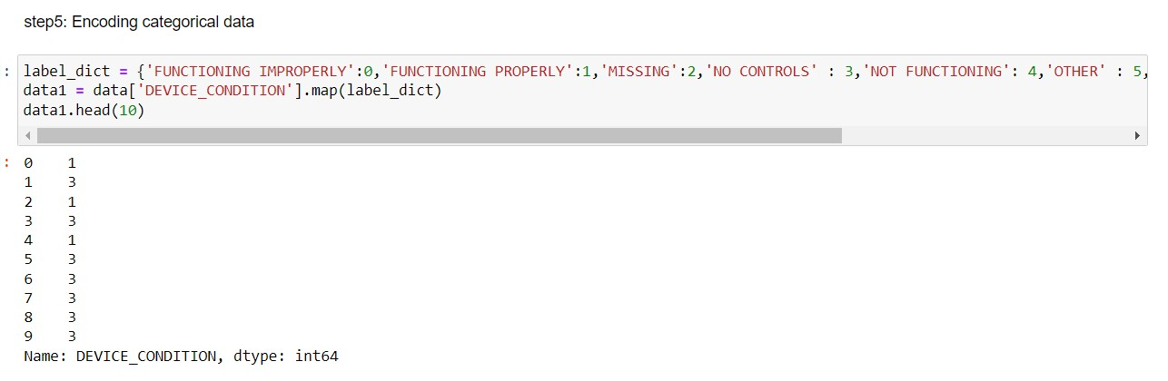
DATA PREPROCESSING
Handling Missing Values: Around 8 columns had more than 90% of missing values. Therefore, we have dropped a few columns based on our aims and imputed some of the columns with “0” and “NA”.
Encoding the categorical data: we have encoded the categorical data for the column “Device Functioning”

Slide 6
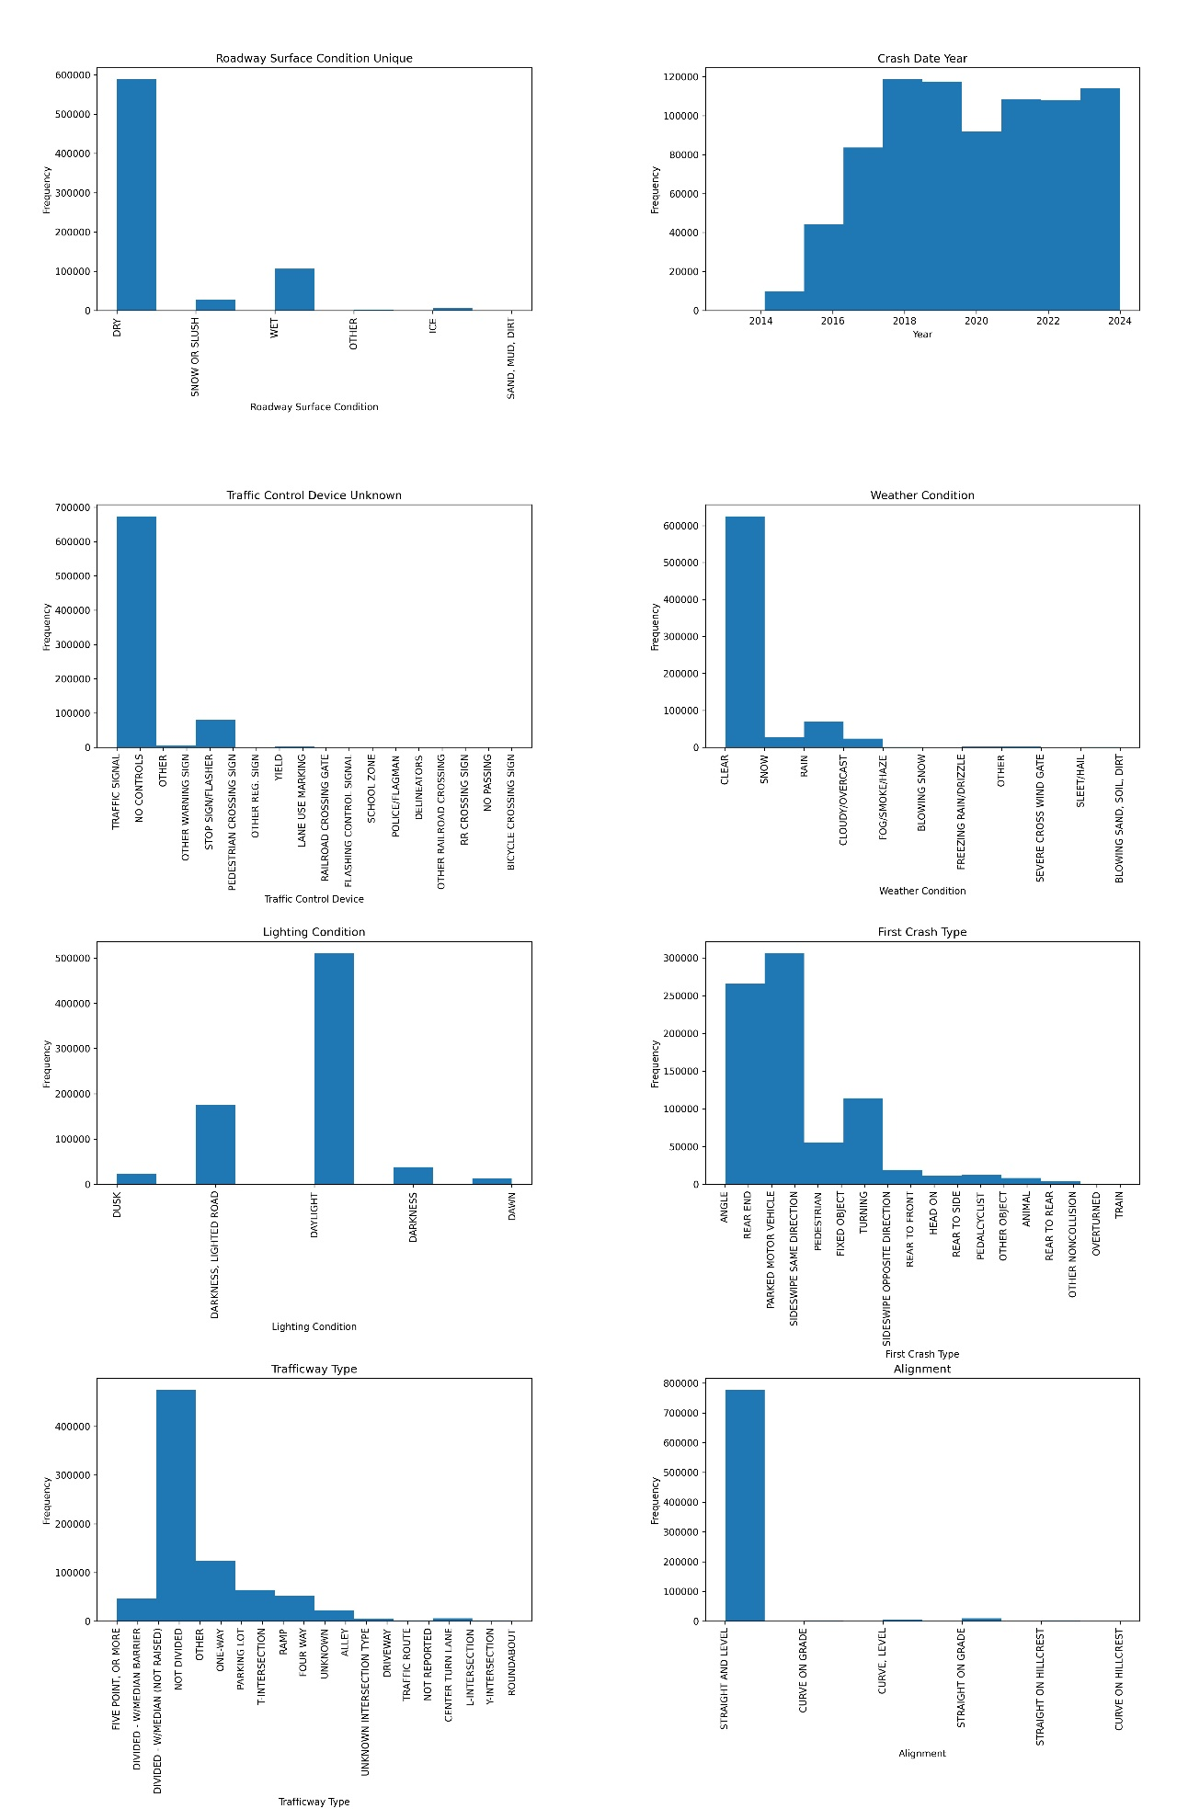
KEY TAKEAWAYS: 1. most accidents occurred on dry roads during daylight& Clear weather conditions. 2. parking lot accidents were prevalent

Slide 7
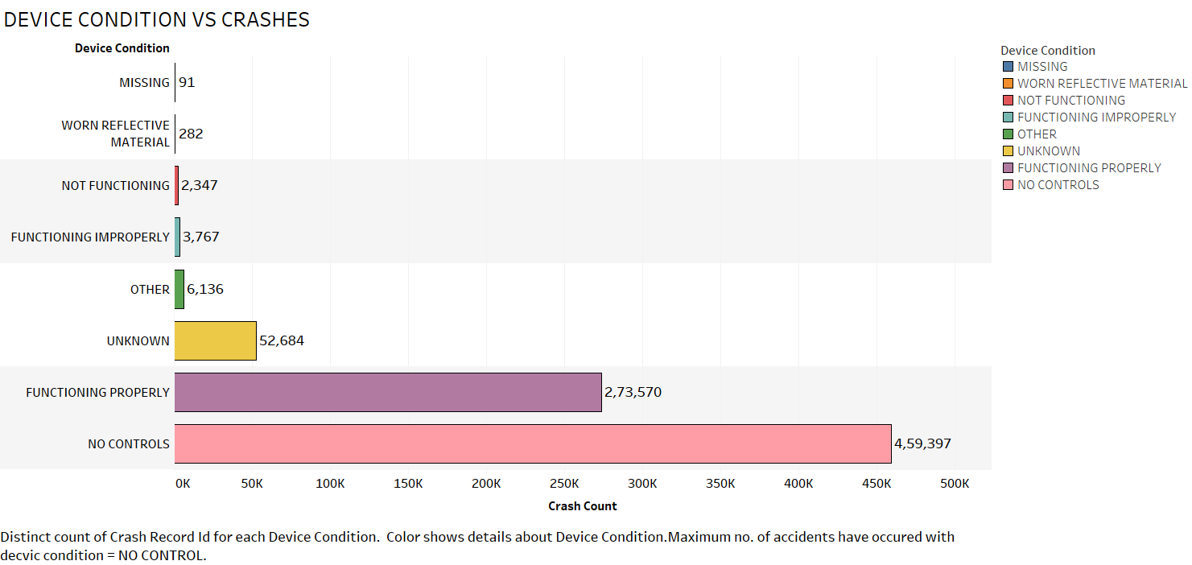
DEVICE CONDITION VS CRASHES
The majority of traffic control devices were not operating correctly when the accidents occurred. This highlights a problem that has to be addressed because doing so could result in a notable decrease in the number of accidents brought on by broken traffic control equipment

Slide 8
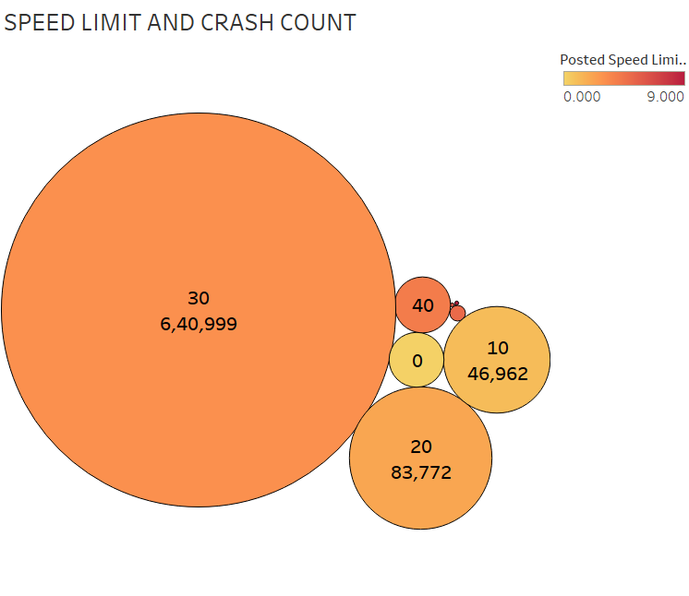
POSTED SPEED LIMIT VS CRASH COUNT
The plot shows that there was a noticeable cluster of accidents that happened while the posted speed limit was thirty. This observation is in line with the state law in Chicago, which stipulates that unless otherwise noted, the default speed limit is 30 mph. With this legal structure in place, it makes sense to assume that a substantial percentage of accidents happened at this pace.

Slide 9
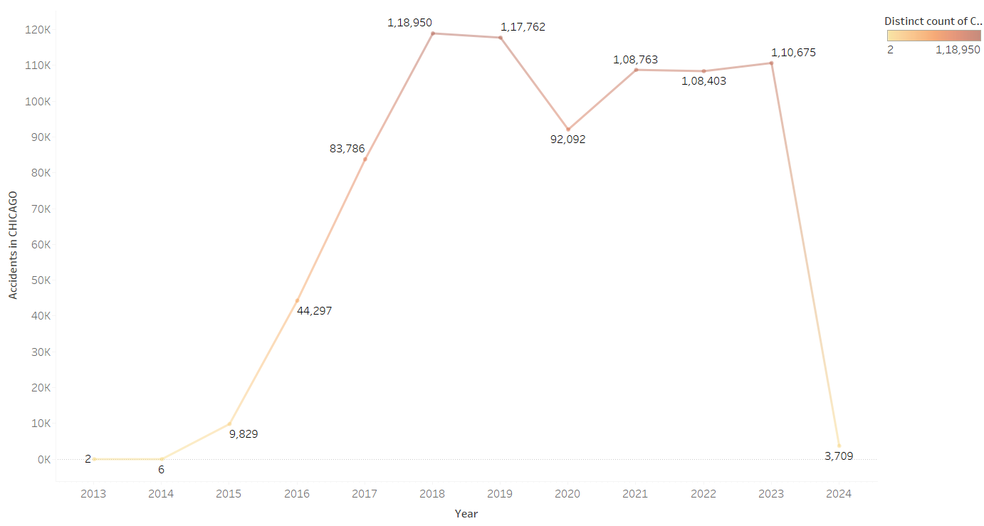
CRASHES VS YEAR
INSIGHTS:
The maximum no. Of crashes occurred in the year 2018.

Slide 10
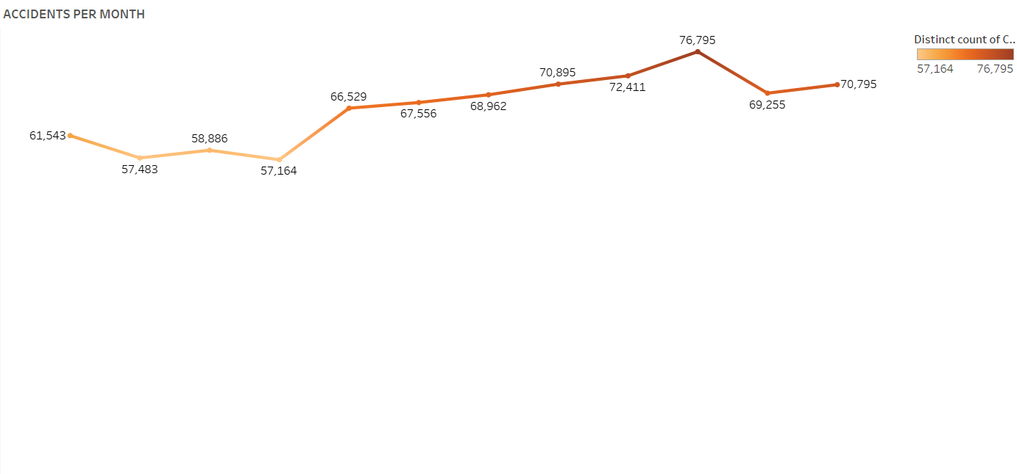
CRASHES VS MONTH
INSIGHTS:
The maximum no. of crashes occurred in the month of October.

Slide 11
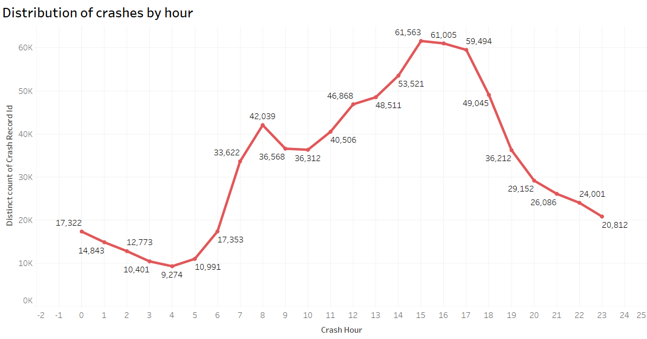
CRASHES VS HOUR
INSIGHTS:
The maximum no. of crashes occurred at 3 PM.

